Slide 1
Session 05: Network
MIS 6311-501 Cyber Security Fundamentals
Chris Davis

Slide 2
Housekeeping
Any Questions? Please do not hesitate to email. Or text.
Class Website: https://elearning.utdallas.edu
Dropbox: https://goo.gl/9AFyoE
UTD Email: cmd140430@utdallas.edu
Gmail: davischr2@gmail.com
Google Voice: 214-771-8122 (Text & Emergencies)
LinkedIn: www.LinkedIn.com/in/ChristopherDavis
Blog: www.cloudauditcontrols.com
Class: Monday 7:00pm-9:45pm JSOM 12.210

Slide 3
Academic Calendar & Sessions

Slide 4
Comparison of Our Class to CISSP Domains
Shon Harris Book – Chapters
Current CISSP Domains
2
Information Security Governance and Risk Management
8
Business Continuity and Disaster Recovery Planning
Security and Risk Management
9
Legal, Regulations, Investigations and Compliance
7
Cryptography
Security Engineering
4
Security Architecture and Design
Security Assessment and Testing
5
Physical (Environmental) Security
Asset Security
6
Telecommunications and Network Security
Communications and Network Security
3
Access Control
Identity and Access Management
11
Operations Security
Security Operations
10
Software Development Security
Software Development Security

Slide 5
Tales from the Crypt.
Practical Applications & Lessons Learned.

Slide 6
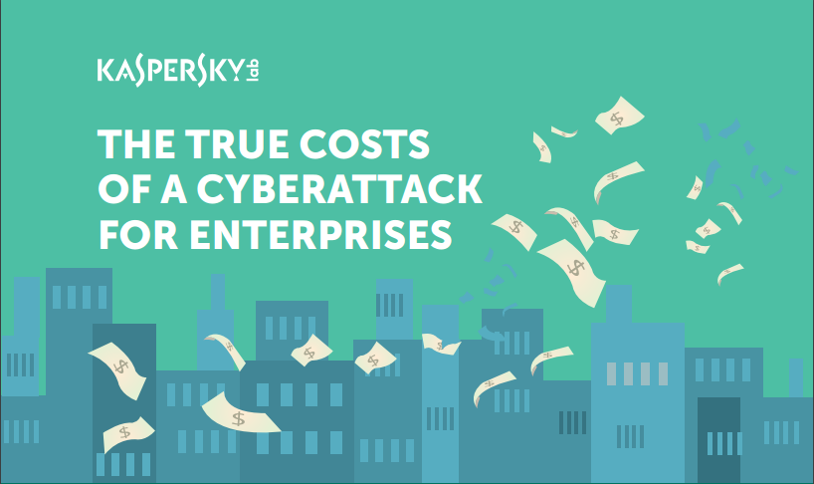
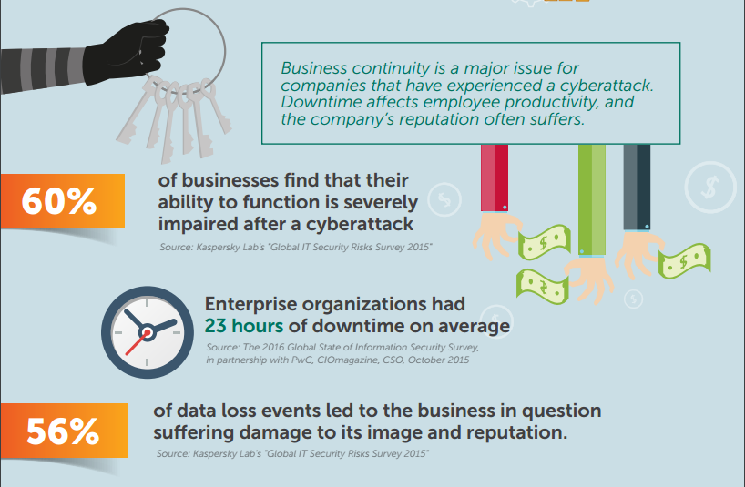
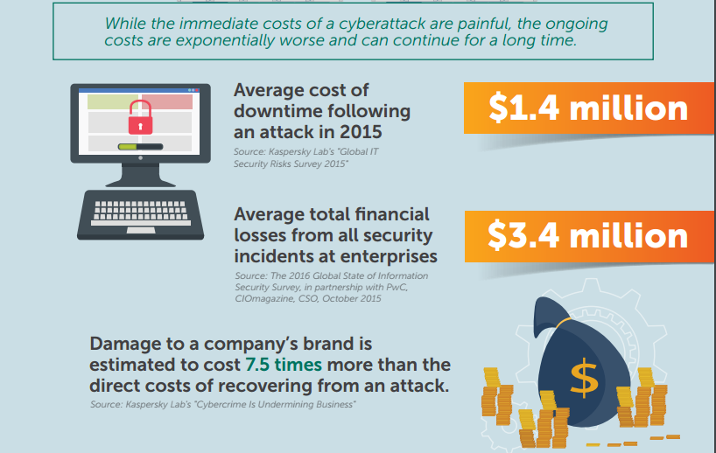
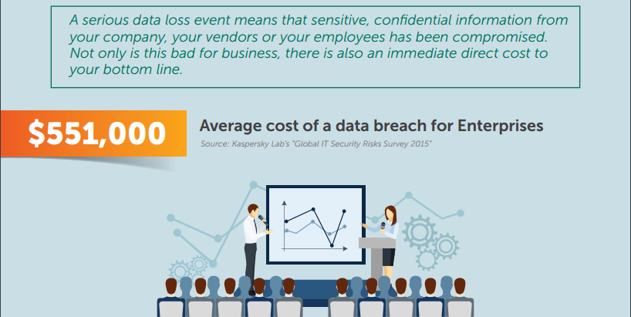
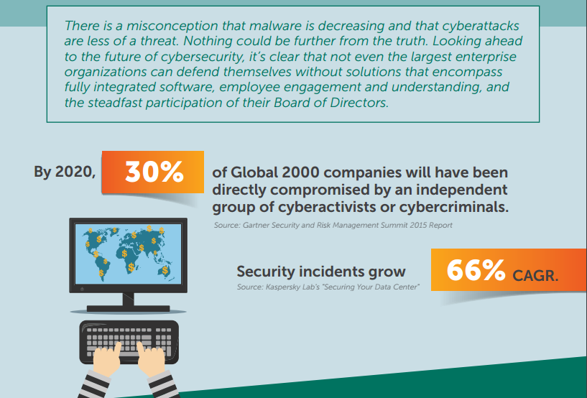
http://go.kaspersky.com/Take-to-the-Board.html
http://go.kaspersky.com/rs/802-IJN-240/images/True%20Cost%20of%20a%20Cyberattack%20Infographic.pdf?

Slide 7


Slide 8
Apple's iOS 9 – appeared with new features and security fixes. A lot of security fixes: 101 potentially exploitable bugs […]
An attacker with a privileged network position may intercept SSL/TLS connections.
A malicious application may be able to leak sensitive user information: applications could access the screen framebuffer while they were in the background.
Processing a maliciously crafted text file may lead to arbitrary code execution: a memory corruption issues existed in the processing of text files. These issues were addressed through improved bounds checking.
Processing a maliciously crafted font file may lead to arbitrary code execution: a memory corruption issue existed in the processing of font files. This issue was addressed through improved input validation.
A malicious application may be able to execute arbitrary code with system privileges: a memory corruption issue existed in dyld. This was addressed through improved memory handling.
An application may be able to bypass code signing: an issue existed with validation of the code signature of executables. This issue was addressed through improved bounds checking.

Slide 9
A malicious application may be able to execute arbitrary code with system privileges: a memory corruption issue existed in IOHIDFamily. This issue was addressed through improved memory handling.
AppleID credentials may persist in the keychain after sign out: an issue existed in keychain deletion. This issue was addressed through improved account cleanup.
Visiting a maliciously crafted website may lead to arbitrary code execution: memory corruption issues existed in WebKit. These issues were addressed through improved memory handling.
An attacker may be able to determine a private key: by observing many signing or decryption attempts, an attacker may have been able to determine the RSA private key. This issue was addressed using improved encryption algorithms.
An attacker can send an email that appears to come from a contact in the recipient's address book.
A malicious enterprise application can install extensions before the application has been trusted.
A maliciously crafted URL may be able to bypass HTTP Strict Transport Security (HSTS) and leak sensitive data.
And so on. Lots of gems in there.

Slide 10
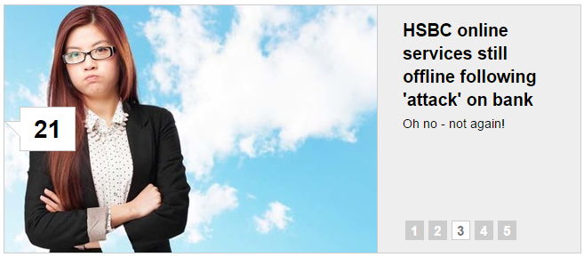
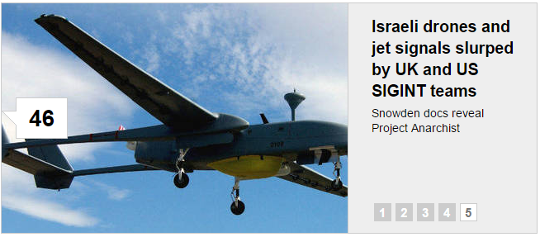
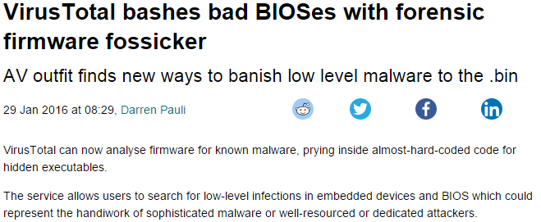
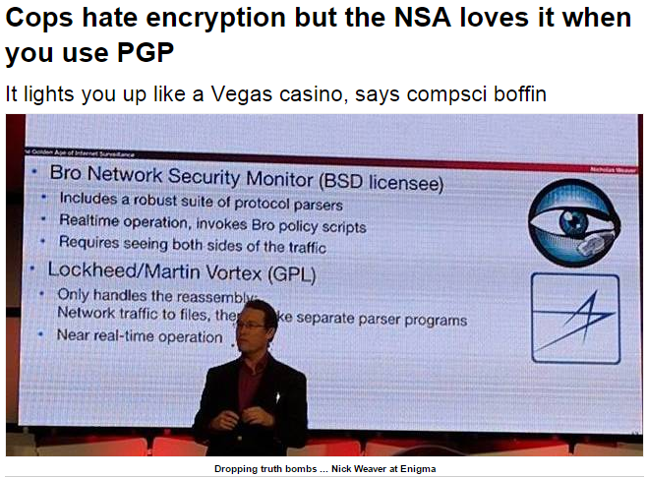
http://www.theregister.co.uk/security/

Slide 11


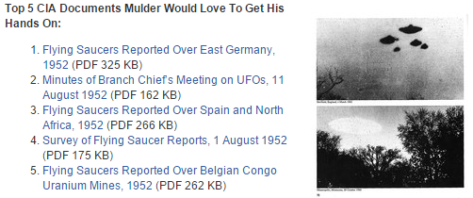
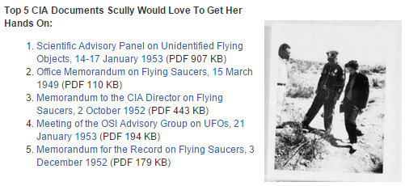
https://www.cia.gov/news-information/blog/2016/take-a-peek-into-our-x-files.html

Slide 12
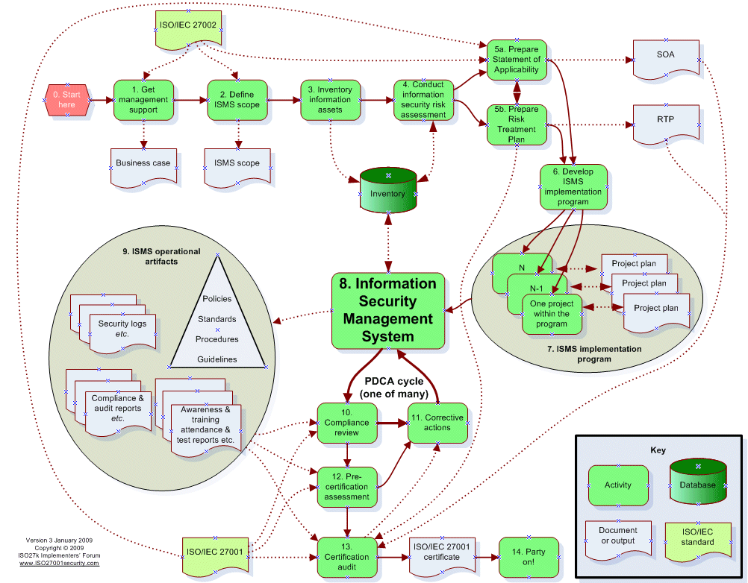
http://www.iso27001security.com/html/toolkit.html

Slide 13

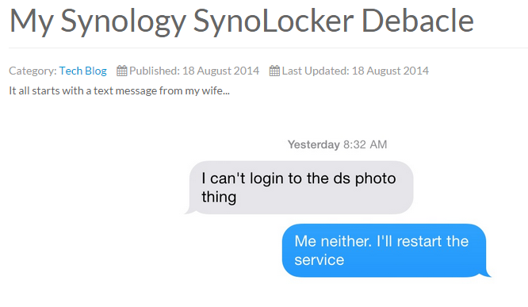
http://kendrickcoleman.com

Slide 14
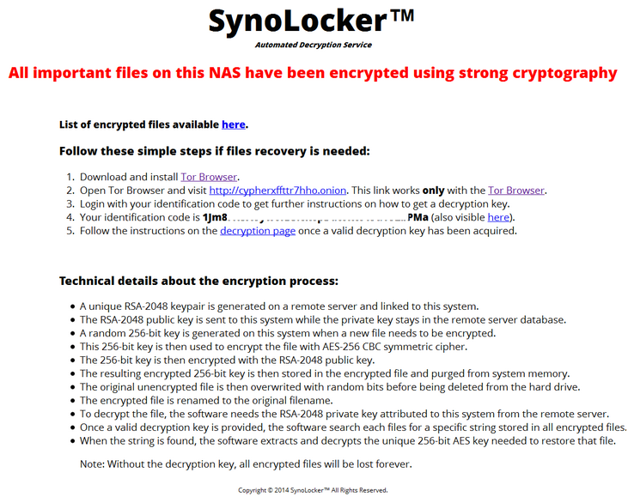

Slide 15
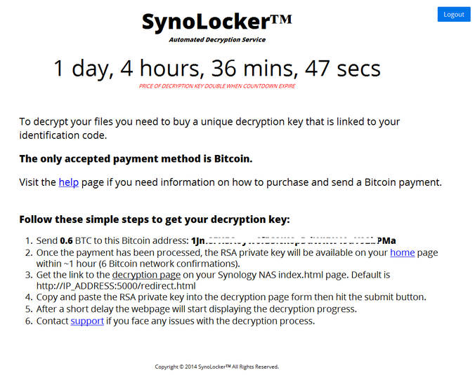

Slide 16
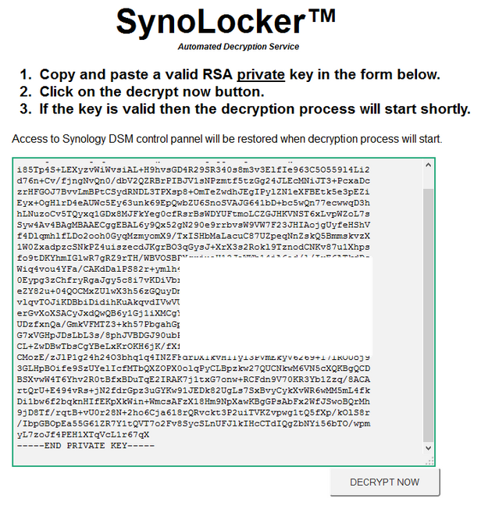

Slide 17
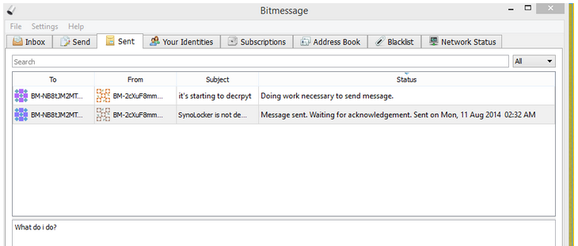

Slide 18
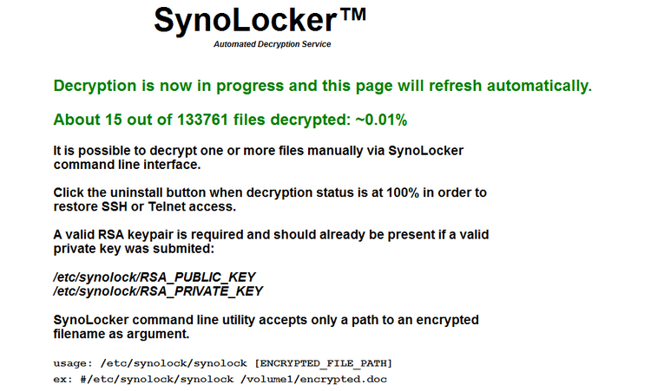

Slide 19
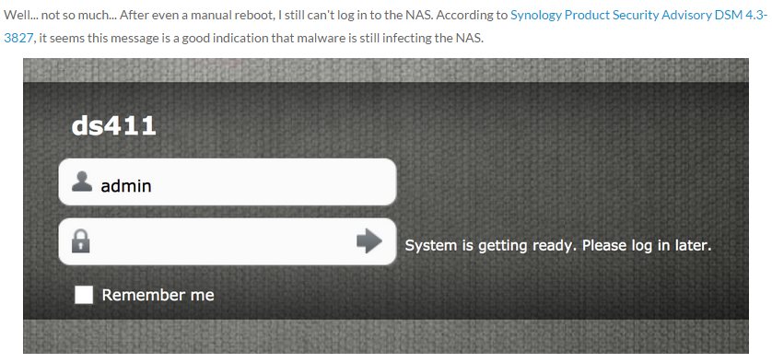
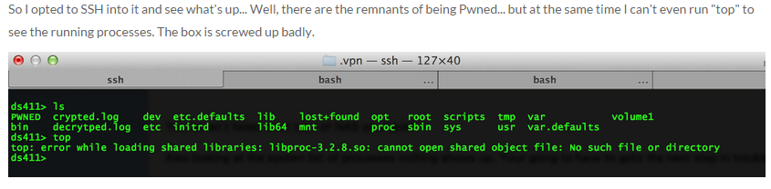

Slide 20
Let’s Get Started.

Slide 21
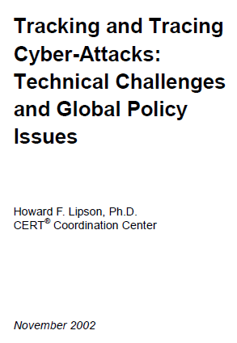
Still Relevant Today.
5 Shortfalls in the Current Internet Environment ...........................................13
5.1 The Internet was never designed for tracking and tracing user
behavior ..................................................................................................13
5.2 The Internet was not designed to resist highly untrustworthy users .........13
5.3 A packet’s source address is untrustworthy, which severely hinders
tracking....................................................................................................14
5.4 The current threat environment far exceeds the Internet’s design
parameters ..............................................................................................15
5.5 The expertise of the average system administrator continues to
decline.....................................................................................................16
5.6 Attacks often cross multiple administrative, jurisdictional, and national
boundaries ..............................................................................................16
5.7 High-speed traffic hinders tracking ..........................................................17
5.8 Tunnels impede tracking..........................................................................18
5.9 Hackers destroy logs and other audit data...............................................18
5.10 Anonymizers protect privacy by impeding tracking ..................................18
5.11 The ability to link specific users to specific IP addresses is being lost......18
5.12 Purely defensive approaches will fail, so deterrence through tracking
and tracing is crucial................................................................................20

Slide 22
2 A Brief History of the Internet
The Internet (originally known as ARPANET) began its life in 1969 as a research network sponsored
by the Advanced Research Projects Agency (ARPA) of the Department of Defense (DoD).
By the end of that year, the ARPANET consisted of four nodes, connecting four U.S. universities,
2 and by 1973 the first international connections to the ARPANET were made.3 In 1982, the
earliest definitions of an internet as an interconnected network of networks began to appear, along
with the establishment of a standard network protocol4 suite to support inter-networking communications.
This protocol suite, comprised of an Internet Protocol (IP) and a Transmission Control
Protocol (TCP), became widely known as “TCP/IP,” which still forms the foundation of network
communications on today’s Internet. In December 1988, as a direct result of the first major computer
security incident on the Internet (the Morris Worm in November 1988), DARPA5 founded
the CERT® Coordination Center (then known as the “Computer Emergency Response Team”) to
provide a central place for coordinated responses to Internet cyber-attacks.
Today, the Internet is an interconnected network of networks comprised of approximately 150
million hosts worldwide.6 The number of computer security incidents handled by the CERT Coordination
Center (CERT/CC) has grown from 6 in 1988, to 52,658 in 2001. By the end of September
2002, the CERT/CC had already seen over 73,000 incidents.7 And yet, despite serious security
shortcomings, TCP/IP is still the standard protocol suite for network communications on
the Internet, greatly limiting our ability to track and trace Internet cyber-attacks to their source.
http://www.sei.cmu.edu/reports/02sr009.pdf
Notes:
2 The first four nodes of the ARPANET connected the University of Southern California (UCLA), Stanford
Research Institute (SRI), the University of California, Santa Barbara (UCSB), and the University
of Utah.
3 University College of London (England) via NORSAR (Norway)
4 A network protocol is a common language for communicating across a network. The protocol specifies
the rules for data format and transmission.
5 By then ARPA had changed its name to DARPA (Defense Advanced Research Projects Agency).
6 As of January 2002, the number of hosts advertised in the Domain Name Service (DNS) was
147,344,723. Source: Internet Software Consortium (http://www.isc.org/).
7 For additional CERT/CC statistics, see http://www.cert.org/stats/.

Slide 23
3 A Brief Tutorial on Internet Technology
At the highest level of abstraction, the Internet is a network of interconnected networks comprised
of a myriad of host computer systems joined together by communications links (wired and
wireless). Host computer systems communicate by sending messages to each other over the
communication links, where a standard network protocol suite called TCP/IP specifies the data
formats and transmission rules.
Looking at a greater level of detail, one sees that the Internet is a packet-switched network. Messages
to be transmitted across the Internet are broken into manageable chunks called IP packets,
which contain the data to be sent (such as part of an email message or web page content); the destination
address (i.e., the “TO” field); the source address (i.e., the “FROM” field); a port number
(which represents a specific type of service offered by a host, such as mail transfer, file transfer,
or web browsing); and other miscellaneous header information that supports the reliable transmission
of data. A vast array of network devices called routers forward each packet, so that it moves
from router to router until it arrives at its desired destination, or until the number of routers
touched by the packet exceeds a maximum allowed value.8 The forwarding of a packet from one
router to a second router is called a hop. Each router has a table of routing information (containing
a snapshot of the network topology) that it builds and updates by communicating with other
routers. The router uses this routing information in an attempt to choose the best path for sending
a packet towards its desired destination. In simplest terms, a router looks at the destination address
of a packet and sends the packet to another router that moves the packet closer to its final
destination.
Notes:
8 One of the header fields in the packet contains a numerical counter called Time To Live (TTL) which is
decremented by one for each hop (i.e., each time a router processes the packet) to prevent infinite looping.
When the counter reaches zero, the packet is no longer forwarded, and a control packet (i.e., a notification)
is sent back to the source address.

Slide 24
Typically, there are many alternative paths to a destination, which enables packets to be routed
around communications links or routers that are out of service due to attack, accident, or even
maintenance. Thus, this packet-switched design allows the Internet to be robust in the face of accidents
or external physical attacks on the routing infrastructure. This, in fact, was one of the
original design goals of the Internet.
TCP attempts to ensure that the packets are successfully delivered, in the proper order, and it will
retransmit packets in the event of their loss. TCP allows two hosts to establish a connection or a
session for a period of time to exchange streams of packets to support a service such as email,
FTP, or web browsing.
Each host on the Internet has an IP address, which allows packets to be delivered to and received
from a specific host. An IP address consists of four decimal numbers in the range 0–255, separated
by periods.9 For example, the IP address of the CERT Coordination Center’s web server is
192.88.209.14. However, it is clearly more mnemonic and convenient for a human to enter a
name like “www.cert.org” in a web browser window than to enter a purely numeric address. An
Internet-wide Domain Name System (DNS)10 supports the translations of IP addresses into hostnames,
using a huge distributed database and a vast number of cooperating systems (DNS name
servers) to provide the DNS name translation service.
Notes:
9 Each decimal number represents 8 bits of a 32-bit binary representation of the IP address.
10 For further information on DNS, see http://www.isc.org/products/BIND/.

Slide 25
Chris's View

Slide 26
Chapter 6: Telecommunications and Network Security

Slide 27
Session Contents
This chapter presents the following:
OSI and TCP/ IP models • Protocol types and security issues • LAN, WAN, MAN, intranet, and extranet technologies • Cable types and data transmission types • Network devices and services • Communications security management • Telecommunications devices and technologies • Remote connectivity technologies • Wireless technologies • Threat and attack types
Notes:
Telecommunications and networking use various mechanisms, devices, software, and protocols that are interrelated and integrated. Networking is one of the more complex topics in the computer field, mainly because so many technologies are involved and are evolving. Our current technologies are improving in functionality and security exponentially, and every month there seems to be new “emerging” technologies that we have to learn, understand , implement, and secure. A network administrator must know how to configure networking software, protocols and services, and devices; deal with interoperability issues; install, configure, and interface with telecommunications software and devices; and troubleshoot effectively. A security professional must understand these issues and be able to analyze them a few levels deeper to recognize fully where vulnerabilities can arise within each of these components and then know what to do about them. This can be an overwhelming and challenging task. However, if you are knowledgeable, have a solid practical skill set, and are willing to continue to learn, you can have more career opportunities than you know what to do with.
Harris, Shon (2012-11-08). CISSP All-in-One Exam Guide, 6th Edition (Kindle Locations 10621-10629). McGraw-Hill Education. Kindle Edition.

Slide 28
Introduction to Networking

Slide 29
What is a Network?
A network is the infrastructure that allows more than one computer to communicate with each other.
A network can be a simple as two computers, or millions of computers. The Internet is the largest network.
Network Hardware includes routers, switches, and a myriad of devices for shaping traffic and various forms of protection.
We will discuss some of these.

Slide 30
Network Origins
USSR's launch of Sputnik scares US into creating the Advanced Research Projects Agency (ARPA) in February 1958
Research suggested packet switching vs circuit switching communications network for survivability in the event of nuclear attack
ARPANET and MILNET born
1969: Packet switched network demonstrated
1973: Work begins on TCP/IP
1983: First TCP/IP Protocol WAN operational

Slide 31
What is a protocol?
Rules for communication
Understood by different types of computers
A protocol is a standard set of rules that determines how computers communicate with each other across networks.
A network is two or more computers that are physically (logically) connected to each other and able to share information.
To understand and act on these messages, computers must agree on what a message means.

Slide 32
Practical Examples
People using Morse Code agree that a given combination of dots and dashes will always have the same meaning.
Someone who speaks only Russian and someone who speaks only Greek can exchange messages using Morse Code because they agree on the format and method for exchanging messages.
The US Post Office:

Slide 33
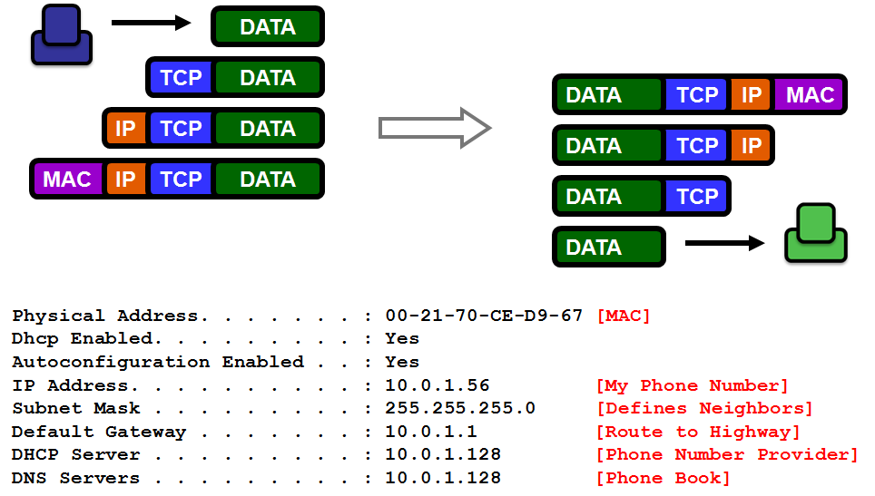
How Your Computer Talks

Slide 34
Data Encapsulation: Protocols in Use
DATA
TCP SEGMENT
IP PACKET
ETHERNET FRAME

Slide 35
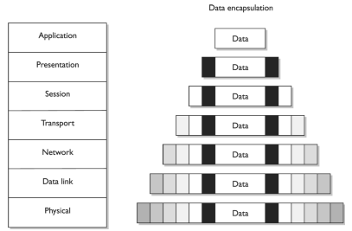
Data Encapsulation

Slide 36
The OSI Model. It’s a Model. It’s only a Model.

Slide 37
OSI Reference Model Data Flow
All People Seem To Need Data Processing.
Please Do Not Throw Sausage Pizza Away.
CLIENT
SERVER
7
Application
7
Application
6
Presentation
6
Presentation
Then up the receiving stack
5
Session
Data travels down the stack
5
Session
4
Transport
4
Transport
3
Network
3
Network
2
Data Link
2
Data Link
1
Physical
1
Physical
Through the network
As the data passes through each layer on the client, information about that layer is added to the data.. This information is stripped off by the corresponding layer on the server.

Slide 38
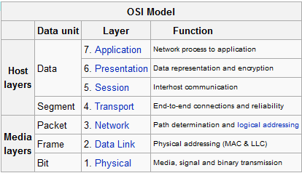
Simplified OSI Model
From Wikipedia…

Slide 39

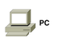


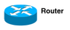


Data Encapsulation: Protocols in Use
DATA
TCP SEGMENT
IP PACKET
ETHERNET FRAME

Slide 40
Simplified OSI Model
Layer | Name | Description
Layer 7 | Application | This layer represents the end user application such as HTTP, FTP, SMTP, or Telnet.
Layer 6 | Presentation | This layer handles formatting, encryption, compression, and presentation of data to the application. Examples include SSL and TLS.
Layer 5 | Session | This layer deals with the setup and management of sessions between computer applications. Examples include named pipes, NetBIOS, and session establishment for TCP.
Layer 4 | Transport | This layer deals with transport issues, such as getting to the destination in one piece and error control. TCP and UDP are perhaps the best known examples in this layer.
Layer 3 | Network | This layer routes packets between networks. Examples include IP, ICMP, IPSec, and ARP. Routers operate at this layer typically using IP addresses.
Layer 2 | Data Link | This layer links data on hosts from one location to another, typically on the Local Area Network (LAN), but sometimes on the Wide Area Network (WAN) too. Examples include Ethernet, Token Ring, FDDI, Frame Relay, and ATM. Switches and bridges operate at this layer, typically using MAC addresses.
Layer 1 | Physical | This layer defines the physical transmission. Modulation and flow control occur at this layer.
Notes:
Functions and Protocols in the OSI Model
For the exam, you will need to know the functionality that takes place at the different layers of the OSI model, along with specific protocols that work at each layer. The following is a quick overview of each layer and its components.
Application
The protocols at the application layer handle file transfer, virtual terminals , network management , and fulfilling networking requests of applications. A few of the protocols that work at this layer include • File Transfer Protocol (FTP) • Trivial File Transfer Protocol (TFTP) • Simple Network Management Protocol (SNMP) • Simple Mail Transfer Protocol (SMTP) • Telnet • Hypertext Transfer Protocol (HTTP)
Presentation
The services of the presentation layer handle translation into standard formats, data compression and decompression, and data encryption and decryption. No protocols work at this layer, just services. The following lists some of the presentation layer standards: • American Standard Code for Information Interchange (ASCII) • Extended Binary-Coded Decimal Interchange Mode (EBCDIC) • Tagged Image File Format (TIFF) • Joint Photographic Experts Group (JPEG) • Motion Picture Experts Group (MPEG) • Musical Instrument Digital Interface (MIDI)
Session
The session layer protocols set up connections between applications; maintain dialog control; and negotiate, establish, maintain, and tear down the communication channel. Some of the protocols that work at this layer include • Network File System (NFS) • NetBIOS • Structured Query Language (SQL) • Remote procedure call (RPC)
Transport
The protocols at the transport layer handle end-to-end transmission and segmentation of a data stream. The following protocols work at this layer: • Transmission Control Protocol (TCP) • User Datagram Protocol (UDP) • Secure Sockets Layer (SSL)/ Transport Layer Security (TLS) • Sequenced Packet Exchange (SPX)
Network
The responsibilities of the network layer protocols include internetworking service, addressing, and routing. The following lists some of the protocols that work at this layer: • Internet Protocol (IP) • Internet Control Message Protocol (ICMP) • Internet Group Management Protocol (IGMP) • Routing Information Protocol (RIP) • Open Shortest Path First (OSPF) • Internetwork Packet Exchange (IPX)
Data Link
The protocols at the data link layer convert data into LAN or WAN frames for transmission and define how a computer accesses a network. This layer is divided into the Logical Link Control (LLC) and the Media Access Control (MAC) sublayers. Some protocols that work at this layer include the following: • Address Resolution Protocol (ARP) • Reverse Address Resolution Protocol (RARP) • Point-to-Point Protocol (PPP) • Serial Line Internet Protocol (SLIP) • Ethernet • Token Ring • FDDI • ATM
Physical
Network interface cards and drivers convert bits into electrical signals and control the physical aspects of data transmission, including optical, electrical, and mechanical requirements. The following are some of the standard interfaces at this layer: • EIA-422, EIA-423, RS-449, RS-485 • 10BASE-T, 10BASE2, 10BASE5, 100BASE-TX, 100BASE-FX, 100BASE-T, 1000BASE-T, 1000BASE-SX • Integrated Services Digital Network (ISDN) • Digital subscriber line (DSL) • Synchronous Optical Networking (SONET)
Harris, Shon (2012-11-08). CISSP All-in-One Exam Guide, 6th Edition (Kindle Locations 10902-10937). McGraw-Hill Education. Kindle Edition.

Slide 41
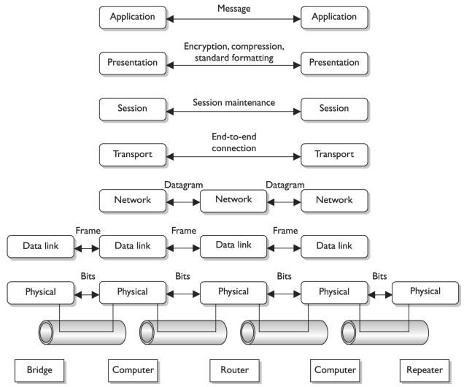

Slide 42
OSI – Learning More about Individual Layers

Slide 43
OSI model – layer 1 physical
Network interface cards and drivers convert bits into electrical signals and control the physical aspects of data transmission, including optical, electrical, and mechanical requirements.
The following are some of the standard interfaces at this layer: • EIA-422, EIA-423, RS-449, RS-485 • 10BASE -T, 10BASE2, 10BASE5, 100BASE-TX, 100BASE-FX, 100BASE -T, 1000BASE-T, 1000BASE-SX • Integrated Services Digital Network (ISDN) • Digital subscriber line (DSL) • Synchronous Optical Networking (SONET)

Slide 44
OSI model – layer 2
The protocols at the data link layer convert data into LAN or WAN frames for transmission and define how a computer accesses a network. This layer is divided into the Logical Link Control (LLC) and the Media Access Control (MAC) sublayers.
Some protocols that work at this layer include the following: • Address Resolution Protocol (ARP) • Reverse Address Resolution Protocol (RARP) • Point-to-Point Protocol (PPP) • Serial Line Internet Protocol (SLIP) • Ethernet • Token Ring • FDDI • ATM

Slide 45
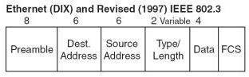
Ethernet Frame

Slide 46
OSI model – layer 3 network
The responsibilities of the network layer protocols include internetworking service, addressing, and routing.
The following lists some of the protocols that work at this layer: • Internet Protocol (IP) • Internet Control Message Protocol (ICMP) • Internet Group Management Protocol (IGMP) • Routing Information Protocol (RIP) • Open Shortest Path First (OSPF) • Internetwork Packet Exchange (IPX)

Slide 47
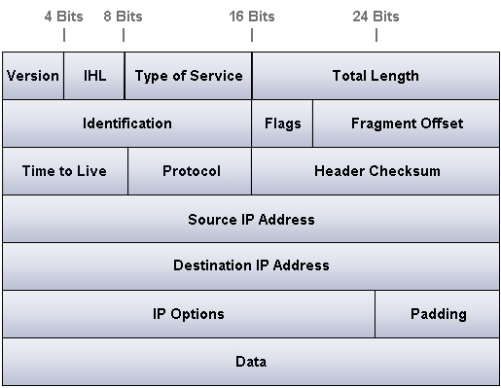
IP Packet

Slide 48
OSI model Layer 4 Transport
The protocols at the transport layer handle end-to-end transmission and segmentation of a data stream.
The following protocols work at this layer: • Transmission Control Protocol (TCP) • User Datagram Protocol (UDP) • Secure Sockets Layer (SSL)/ Transport Layer Security (TLS) • Sequenced Packet Exchange (SPX)

Slide 49
OSI Model Layer 5 Session
The session layer protocols set up connections between applications; maintain dialog control; and negotiate, establish, maintain, and tear down the communication channel.
Some of the protocols that work at this layer include • Network File System (NFS) • NetBIOS • Structured Query Language (SQL) • Remote procedure call (RPC)

Slide 50
OSI model Layer 6 – Presentation
The services of the presentation layer handle translation into standard formats, data compression and decompression , and data encryption and decryption. No protocols work at this layer, just services.
The following lists some of the presentation layer standards: • American Standard Code for Information Interchange (ASCII) • Extended Binary-Coded Decimal Interchange Mode (EBCDIC) • Tagged Image File Format (TIFF) • Joint Photographic Experts Group (JPEG) • Motion Picture Experts Group (MPEG) • Musical Instrument Digital Interface (MIDI)

Slide 51
OSI model Layer 7 – Application
The protocols at the application layer handle file transfer, virtual terminals, network management, and fulfilling networking requests of applications.
A few of the protocols that work at this layer include • File Transfer Protocol (FTP) • Trivial File Transfer Protocol (TFTP) • Simple Network Management Protocol (SNMP) • Simple Mail Transfer Protocol (SMTP) • Telnet • Hypertext Transfer Protocol (HTTP)

Slide 52
Quick OSI review
What layer is creates a connection between 2 applications?
What layer turns the frames sent to it into the proper voltages and timings to send across a wire?
What layer is concerned with finding paths between different networks?
What layer is concerned with the formatting of the data?
What layer is concerned with communicating between two of the? same interface types on computers on the same LAN?
What layer creates a connection between two computers?
What layer is concerned with the data/protocol that the application you are using uses?

Slide 53
TCP/IP model

Slide 54
TCP/IP
TCP/IP is a suite of protocols that define IP communications.
IP is a network layer protocol, and handles addressing and routing
We use IP version 4
Increasingly using IP version 6

Slide 55
IP Address
The main components of an IP address
IP address
4 “sections” (called OCTETS*) each octet a number from 0-255
Example: 192.168.100.104 or 130.85.1.4
Net mask
4 “sections” (octet) each octet a number of
0, 128, 192, 224, 240, 248, 252, 254, 255 (usually 0 or 255)
Example: 255.255.255.0 or 255.255.240.0
What is the net mask used for?

Slide 56
IP address and subnet mask
Think of your network portion as your zip code. All addresses with your zip code are in your same town served by your post office.
All zip codes different are in a different town with a different post office.
Your host part is your street address

Slide 57
IP addresses and subnet
Most of the net masks you will see contain either 255 or 0. 255 means that “octet” of the IP address is all “network” part, 0 means it’s all host part. In real life things can get more complicated than this.. Though people try to avoid it and you probably don’t have to worry about this for the CISSP exam.
Example: 192.168.100.14
255.255.255.240
You cannot directly look at the IP address to determine whether a host is on the same network as you. (in this case computers with an IP of 192.168.100.0 -192.168.100.15 are on your same network.. All others are NOT
(192.168.100.17 would be on a different network)

Slide 58
TCP/IP
We currently use IPv4 with has 2^32 addresses
about 4 billion IP addresses
IPv6 has 2^128 addresses (4 billion x 4 billion)
IPv6 also has
a simplified format
additional features such as IPSEC. (talk about IP SEC later)

Slide 59
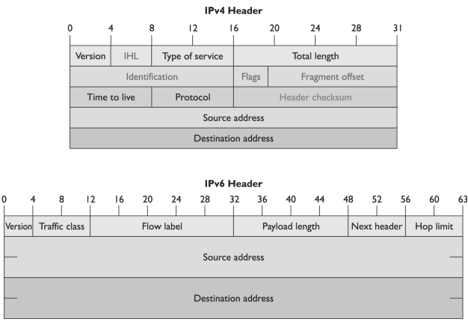
IPV4 vs. IPV6

Slide 60
TCP & UDP Protocols
This is an introduction. Reference the book for more information.

Slide 61
TCP/UDP
TCP/UDP handle the transport and session layers. They setup a communications channel between two programs talking over the network
Programs talk via ports which are numbers that generally define what program/services you want to talk to (talk about this in a couple slides)
More on TCP/UDP in the next slides

Slide 62
TCP
Connection oriented “guaranteed” delivery.
Advantages
Easier to program with
Truly implements a session
Adds security
Disadvantages
More overhead / slower

Slide 63
UDP
Connectionless, non-guaranteed delivery (best effort)
Advantages
Fast / low overhead
Disadvantages
Harder to program with
No true sessions
Less security
A pain to firewall (due to no connections)

Slide 64
UDP
Like a postcard, each packet is separate
No guarantee on delivery
Best effort
Fast, little overhead
No sequence numbers (ordering)
No acknowledgements
No connection
Security issues due to lack of a connection

Slide 65
Circuit vs. Packet Switched
Circuit Switching
Constant traffic
Fixed delays
Connection oriented
Sensitive to loss of connection
TRADITIONALLY Voice oriented
Packet Switching
Burst traffic
Variable delays
Connectionless
Sensitive to loss of data
TRADITIONALLY Data oriented

Slide 66
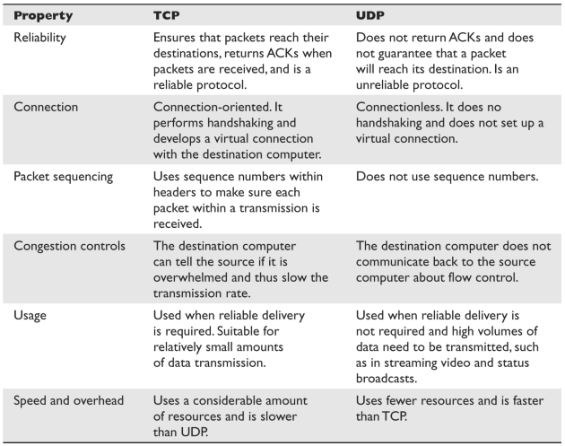
TCP vs. UDP

Slide 67
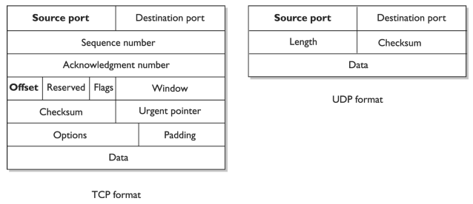
TCP vs. UDP

Slide 68
Ports - 503
Both TCP and UDP use ports as the end points of conversations. Ports for services that are defined and static are called well known ports some well know ports are*
telnet TCP/23
Email (SMTP) TCP/25
Email (POP) TCP/110
Email (IMAP) TCP/143
Web (HTTP) TCP/80
Web (HTTPS) TCP/443
DNS TCP & UDP 53
FTP TCP/21 & 20

Slide 69
Registered Ports
The following shows some of the most commonly used protocols and the ports to which they are usually mapped:
Telnet port 23
SMTP port 25
HTTP port 80
SNMP ports 161 and 162
FTP ports 21 and 20
Registered ports are 1024 to 49151, which can be registered with the Internet Corporation for Assigned Names and Numbers (ICANN) for a particular use. Vendors register specific ports to map to their proprietary software. Dynamic ports are 49152 to 65535 and are available to be used by any application on an “as needed” basis.

Slide 70
Common Data Network Services
File sharing
Mail sending
Printing
Client/server
Domain Name Service (DNS)

Slide 71
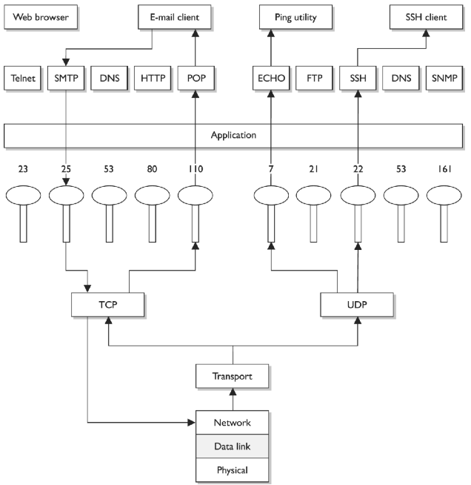
Mapping Ports to Services

Slide 72
Network Transmission

Slide 73
Key Terms
Unshielded twisted pair Cabling in which copper wires are twisted together for the purposes of canceling out EMI from external sources. UTP cables are found in many Ethernet networks and telephone systems.
Shielded twisted pair Twisted -pair cables are often shielded in an attempt to prevent RFI and EMI. This shielding can be applied to individual pairs or to the collection of pairs.
Attenuation Gradual loss in intensity of any kind of flux through a medium. As an electrical signal travels down a cable, the signal can degrade and distort or corrupt the data it is carrying.
Crosstalk A signal on one channel of a transmission creates an undesired effect in another channel by interacting with it. The signal from one cable “spills over” into another cable.
Plenum cables Cable is jacketed with a fire-retardant plastic cover that does not release toxic chemicals when burned.

Slide 74
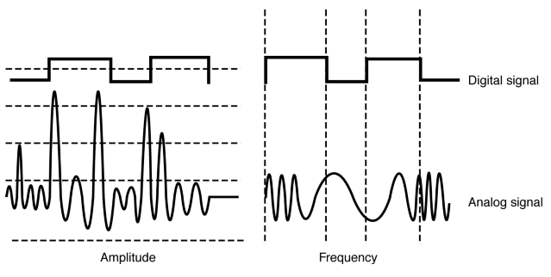
Analog and Digital

Slide 75
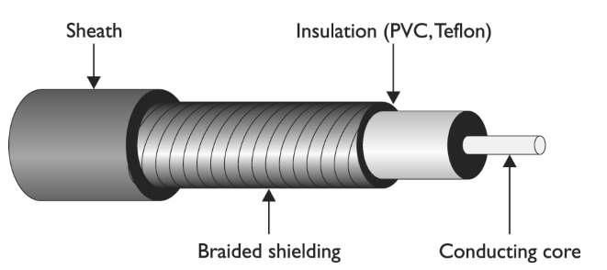
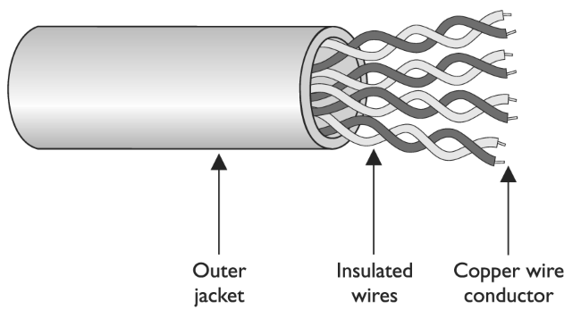
Coaxial Cable Vs. Twisted-Pair Cable

Slide 76
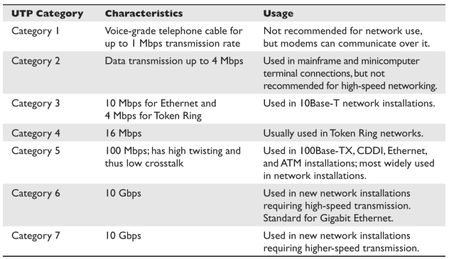
UTP Cable Ratings

Slide 77
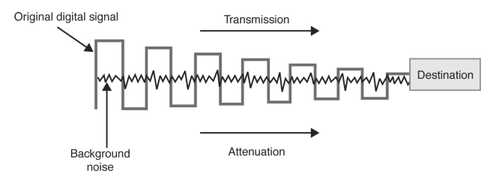
Background Noise and Attenuation

Slide 78
LAN Topologies

Slide 79
Key Terms
Ring topology Each system connects to two other systems, forming a single, unidirectional network pathway for signals, thus forming a ring.
Bus topology Systems are connected to a single transmission channel (i.e., network cable), forming a linear construct.
Star topology Network consists of one central device, which acts as a conduit to transmit messages. The central device, to which all other nodes are connected, provides a common connection point for all nodes.
Mesh topology Network where each system must not only capture and disseminate its own data, but also serve as a relay for other systems; that is, it must collaborate to propagate the data in the network.

Slide 80
LAN Topologies
Star
Bus
Tree
Ring
Mesh

Slide 81
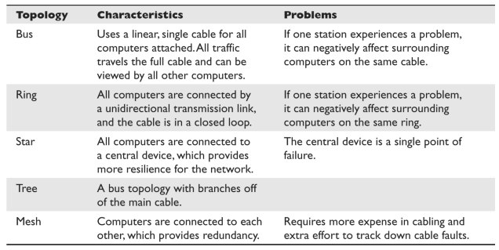
Summary of LAN Topologies

Slide 82
Data Network Types
Personal Area Network - PAN
Bluetooth
Local Area Network - LAN
Campus Area Network – CAN
Metropolitan Area Network – MAN
Wide Area Network – WAN
Internet – worldwide network
Intranet – company network
Extranet – shared partner or vendor network

Slide 83
Key Terms – Media Sharing
CSMA/CD Carrier sense multiple access with collision detection A media access control method that uses a carrier sensing scheme. When a transmitting system detects another signal while transmitting a frame, it stops transmitting that frame, transmits a jam signal, and then waits for a random time interval before trying to resend the frame. Random collision timer is called the back-off algorithm. This reduces collisions on a network.
CSMA/CA Carrier sense multiple access with collision avoidance A media access control method that uses a carrier sensing scheme. A system wishing to transmit data has to first listen to the channel for a predetermined amount of time to determine whether or not another system is transmitting on the channel. If the channel is sensed as “idle,” then the system is permitted to begin the transmission process. If the channel is sensed as “busy,” the system defers its transmission for a random period of time.

Slide 84
Basic Networking Concepts

Slide 85
Key Terms
Internet Group Management Protocol (IGMP) Used by systems and adjacent routers on IP networks to establish and maintain multicast group memberships.
Media access control (MAC) Data communication protocol sublayer of the data link layer specified in the OSI model. It provides hardware addressing and channel access control mechanisms that make it possible for several nodes to communicate within a multiple -access network that incorporates a shared medium.
Address Resolution Protocol (ARP) A networking protocol used for resolution of network layer IP addresses into link layer MAC addresses.
Dynamic Host Configuration Protocol (DHCP) A network configuration service for hosts on IP networks. It provides IP addressing, DNS server, subnet mask, and other important network configuration data to each host through automation.
DHCP snooping A series of techniques applied to ensure the security of an existing DHCP infrastructure through tracking physical locations, ensuring only authorized DHCP servers are accessible, and hosts use only addresses assigned to them.

Slide 86
Key Terms
Reverse Address Resolution Protocol (RARP) and Bootstrap Protocol (BootP) Networking protocols used by host computers to request the IP address from an administrative configuration server.
Internet Control Message Protocol (ICMP) A core protocol of the IP suite used to send status and error messages.
Simple Network Management Protocol (SNMP) A protocol within the IP suite that is used for network device management activities through the use of a structure that uses managers, agents, and Management Information Bases.
Domain Name System (DNS) A hierarchical distributed naming system for computers, services, or any resource connected to an IP-based network. It associates various pieces of information with domain names assigned to each of the participating entities.
DNS zone transfer The process of replicating the databases containing the DNS data across a set of DNS servers.

Slide 87
LAN Communication Methods
Unicast
Single source to single destination
Multicast
Single source to multiple specific destinations
Broadcast
Single source to every destination reachable on a network segment

Slide 88
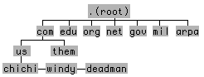
The Domain Name System (DNS)
Notes:
In order to understand how a DNS server works, you should be familiar with what is called the domain name space. It sounds a little ominous, I know, but really it's quite simple. In fact, you've probably seen it at one time or another represented by an inverted tree.Each node on the tree represents a domain. Everything below a node falls into its domain. One domain can be part of another domain. For example, the machine chichi is part of the .us domain as well as the .com domain. DNS software is generally made up of two elements: the actual name server, and something called a resolver. The name server responds to browser requests by supplying name-to-address conversions. When it doesn't know the answer, the resolver will ask another name server for the information. To see how it works, let's go back to the domain-name-space inverted tree. When you type in a URL, your browser sends a request to the closest name server. If that server has ever fielded a request for the same host name (within a time period set by the administrator to prevent passing old information), it will locate the information in its cache and reply. If the name server is unfamiliar with the domain name, the resolver will attempt to "solve" the problem by asking a server farther up the tree. If that doesn't work, the second server will ask yet another - until it finds one that knows. (When a server can supply an answer without asking another, it's known as an authoritative server.)

Slide 89
The Root Servers
nslookup -q=ns .
A.ROOT-SERVERS.NET internet address = 198.41.0.4
B.ROOT-SERVERS.NET internet address = 192.228.79.201
C.ROOT-SERVERS.NET internet address = 192.33.4.12
D.ROOT-SERVERS.NET internet address = 128.8.10.90
E.ROOT-SERVERS.NET internet address = 192.203.230.10
F.ROOT-SERVERS.NET internet address = 192.5.5.241
G.ROOT-SERVERS.NET internet address = 192.112.36.4
H.ROOT-SERVERS.NET internet address = 128.63.2.53
I.ROOT-SERVERS.NET internet address = 192.36.148.17
J.ROOT-SERVERS.NET internet address = 192.58.128.30
K.ROOT-SERVERS.NET internet address = 193.0.14.129
L.ROOT-SERVERS.NET internet address = 198.32.64.12
M.ROOT-SERVERS.NET internet address = 202.12.27.33

Slide 90
Address Resolution Protocol (ARP)
Maps IP addresses to physical Ethernet network addresses
Maintains a table of translations between IP addresses and Ethernet addresses
Table is built dynamically
ARP receives request to translate an IP address
Checks for the address in table
If not found, ARP broadcasts a packet to every host on the Ethernet
Response comes back, and is added to ARP table
ARP tables are typically very stable
Don’t require any attention
Notes:
The ARP software maintains a table of translations between IP addresses and Ethernet addresses. This table is built dynamically. When ARP receives a request to translate an IP address, it checks for the address in this table. If the address is not found in the table, ARP broadcasts a packet to every host on the Ethernet. The packet contains the IP address as its own, it responds by sending its Ethernet address back to the requesting host. The response is then cached in the ARP table.

Slide 91
ARP Table
server1 # arp -a
Device IP Address Mask Flags Phys Addr
------ -------------------- --------------- ----- ---------------
le0 moon1 255.255.255.255 08:00:20:0d:52:54
le1 sun1 255.255.255.255 08:00:20:0d:4e:66
le1 sun4 255.255.255.255 08:00:20:0d:51:ce
le1 sun3 255.255.255.255 08:00:20:0d:8b:a3
le1 sun2 255.255.255.255 08:00:20:0d:4c:e1
le0 moon2 255.255.255.255 08:00:20:0d:86:0c
le0 moon3 255.255.255.255 08:00:20:0d:4c:21
le0 moon4 255.255.255.255 08:00:20:0d:8f:87
le1 sun6 255.255.255.255 08:00:20:0d:4b:7d
le0 moon5 255.255.255.255 08:00:20:0d:8c:45
le1 inst1 255.255.255.255 08:00:20:0d:8b:d3
le0 inst2 255.255.255.255 00:a0:24:7d:f7:99
le0 server1 255.255.255.255 SP 08:00:20:13:2f:3c
le1 server1-rt 255.255.255.255 SP 08:00:20:13:2f:3c
le1 224.0.0.0 240.0.0.0 SM 01:00:5e:00:00:00
le0 224.0.0.0 240.0.0.0 SM 01:00:5e:00:00:00
server1 #
Notes:
An example of what an ARP table looks like. Typically the ARP table will contain this type of information. In our example, the table contains device name (le0), which maps to an IP address (moon1) which isn’t really an IP address but maps to a DNS entry or HOST entry somewhere which will convert it to an IP address. The subnet mask is next, any applicable flags (SP – static publish, SM – static multicast), and the ethernet physical address for that device.
Mask – defines the size of the subnetwork, eg. 255.255.255.255 is a single host device, not a network, 240.0.0.0 is a huge class A network.
S – static (not learned by the ARP protocol)
P – publish (interface will respond to that address and talk to it)
M – mapping (used for multicast entry)
U – unresolved (waiting for ARP response)
The server1# is the actual prompt that the user who has listed out this ARP entry had on his screen, that is why you see it again at the bottom.

Slide 92
Network Devices

Slide 93
Data Network Types
Personal Area Network - PAN
Bluetooth
Local Area Network - LAN
Campus Area Network – CAN
Metropolitan Area Network – MAN
Wide Area Network – WAN
Internet – worldwide network
Intranet – company network
Extranet – shared partner or vendor network

Slide 94
Basic Networking Devices (541)
There are different types of networking devices that exist we will look at
Repeaters
Hubs
Bridges
Switches
Routers

Slide 95
Repeaters - 541
Layer 1 device
No intelligence
Simply repeats and electrical signal from an input to an output.
Used to increase range (ex. Put a repeater 200 meters down a 10Base2 run to double the length)

Slide 96
Hub (542)
Multiport repeater
The initial way to connect computer together in a STAR configuration, using twisted pair wiring (really still a BUS)
Layer 1 device
No intelligence
Just repeats a signal down ALL the wires

Slide 97
Bridge (542)
A bridge connects two segments of the SAME LAN together. However a bridge has some interesting features
It is intelligent, it learns which MAC addresses are on each side of the bridge and uses that to determine how to send traffic
A bridge isolates traffic to each side of the bridge and only forwards it across the bridge if necessary (good for security and performance) See next 3 slides

Slide 98
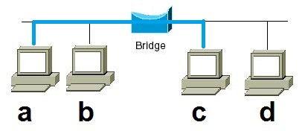
Bridge
A bridge learns which computers (MAC addresses) are on each side of the bridge) It will forward traffic across the bridge if necessary.

Slide 99
Switch (546)
A network Switch is just a multi-port bridge. Switches will often have 24 or more ports, and learns which MAC addresses are on which ports.
Works at layer 2 (data link)
On a switch a computer can send data AND receive data at the same time (full duplex… increasing performance by up to 2x)
On a switch each port is it’s own collision domain, and will not have a collision, therefore allowing line speed communication on each port
more

Slide 100
Switch (546)
A switch does not alter broadcast domains
A switch only sends traffic from the sending computer to the receiving computer, therefore stops sniffing (watch for MAC flooding attacks though)
Since switches inspect the MAC address on all traffic, a switch can be programmed to only allow certain MAC addresses to communicate, and ignore other MAC addresses.

Slide 101
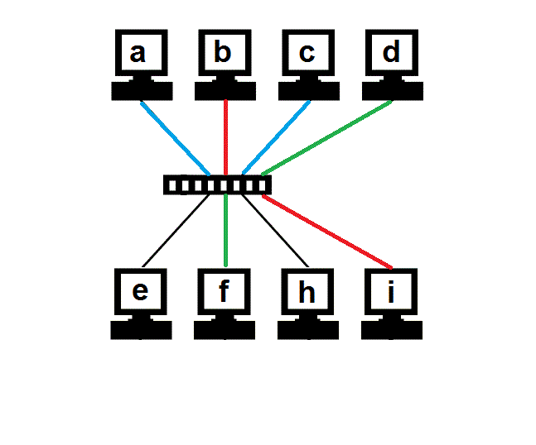
Switch
Multiple conversations can occur on a switch at the same time!

Slide 102
VLANs (549)
A VLAN is the concept of creating multiple broadcast domains (LANs) on a single switch
Two different VLAN protocols
802.1q*, or Cisco ISL* for trunking between switches
Use VLANS for convenience and for creating network security zones.
Combine with 802.1x for dynamic VLAN assignment

Slide 103
Routers (544)
Routers connect different networks.
Move packets between networks
Find the optimal path between networks
Layer 3 (network) devices
Look at IP addresses not MAC addresses
Routers do not forward broadcasts, as such they create different broadcasts domain
Can statically determine routes, or dynamically
Can apply access control lists to allow or deny certain types of traffic

Slide 104
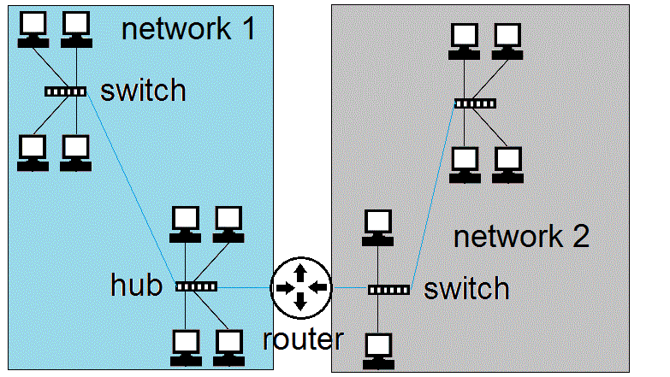
Router (544)
Routers create separate LAN networks. These networks will have different IP ranges
192.168.1.0 / 255.255.255.0 10.1.2.0 / 255.255.255.0

Slide 105
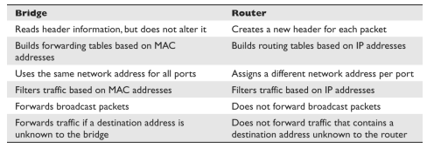
Bridge vs. Router

Slide 106
Gateway - 550
Generic Term for something that connects two separate things together (can be any level).
Default gateway = router to get you off your network
Application gateways – work at the application level and help translate between two different applications (NFS <-> SMB).
Email Gateway – translate between different email types. (Exchange and SMTP)

Slide 107
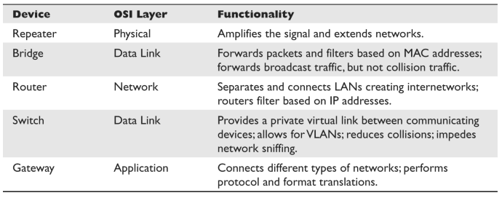
Network Device Summary

Slide 108
Firewalls

Slide 109
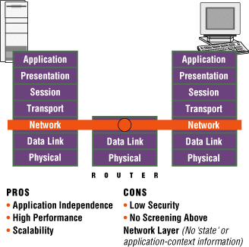
Firewall – Packet Filtering
Notes:
1st generation firewall products refer to “packet filtering” or “screening routers” that deny access of specific apps & services based on ACLs that enable access only for authorized port numbers (app. or service) &/or source & destination Internet Protocol addresses.
Figure is based on OSI Protocol Model. Depicts the relationship & security actions between the server/host (left side of figure), firewall mechanism (middle) and remote client (right side). The red path indicates the communications layers on which the service/host, firewall mechanism and client operate. For example, in this figure the server/host, firewall and client utilize the information available from the physical (layer 1), data link (layer 2) and network (layer 3).
The packet-filtering or screening router operates only on information from the physical, data link and network layers for access control, i.e., enforces network security policy based only on physical ports (physical layer) and IP addresses (data link layer). The access control (depicted by the red path) indicates that the firewall router does not operate above the network layer. Consequently, the router is incapable of using “state” or “application context” information for enforcement of network security policy.
They are the least secure type of firewall because they are not application aware, that is, they cannot understand the context of a given communication, making them easier for hackers to break.

Slide 110
Packet Filter
Packet filtering is a firewall technology that makes access decisions based upon network-level protocol header values. The device that is carrying out packet filtering processes is configured with ACLs , which dictate the type of traffic that is allowed into and out of specific networks.
Packet filtering was the first generation of firewalls and it is the most rudimentary type of all of the firewall technologies.
The filters only have the capability of reviewing protocol header information at the network and transport levels and carrying out PERMIT or DENY actions on individual packets.
This means the filters can make access decisions based upon the following basic criteria:
Source and destination IP addresses
Source and destination port numbers
Protocol types
Inbound and outbound traffic direction

Slide 111
Stateful firewall
router keeps track of a connections in a table. It knows which conversations are active, who is involved etc.
It allows return traffic to come back where a packet filter would have to have a specific rule to define returned traffic
More complex, and can launch DoS against by trying to fill up all the entries in the state tables/use up memory.
Context dependant access control*
Notes:
Stateful-Inspection Firewall Characteristics The following lists some important characteristics of a stateful-inspection firewall: • Maintains a state table that tracks each and every communication session • Provides a high degree of security and does not introduce the performance hit that application proxy firewalls introduce • Is scalable and transparent to users • Provides data for tracking connectionless protocols such as UDP and ICMP
Harris, Shon (2012-11-08). CISSP All-in-One Exam Guide, 6th Edition (Kindle Locations 12846-12850). McGraw-Hill Education. Kindle Edition.

Slide 112
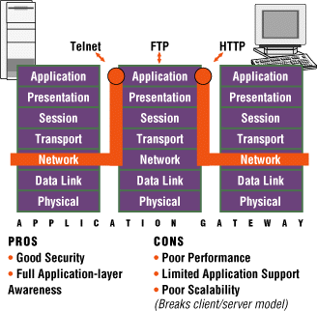
Firewall – Proxy Server
Notes:
2nd generation firewalls are application firewall systems that implement ACLs with application gateways &/or “proxy servers” for specific apps & services.
The app. gateways & proxy servers execute trusted code for apps services in place of the generic servers which contain known vulnerabilities & security flaws. App. gateways & proxy servers are enabled on the basis of a security model & policy.
The application firewall operates at the application layer and is aware of information from all 7 layers. However, it utilizes only the application layer for enforcement of network security policy. Also, as depicted by the broken red path, the client does not communicate directly with the service/host. The client-to-service/host communications are through a “proxy-server” provided by the application firewall.. Consequently, full services of the client/server model are not available and it is said that the model is broken. Also, the performance and scalability are constrained by the proxy server, although some improvements have been realized by using “adaptive” application gateways for specific applications and services, i.e., improved proxy services.
Application gateways improve on security by examining all application layers, bringing context information into the decision process. However, they do this by breaking the client/server model. Every client/server communication requires two connections: one from the client to the firewall, and one from the firewall to the server. In addition, each proxy requires a different application process, or daemon, making scalability and support for new applications a problem.

Slide 113
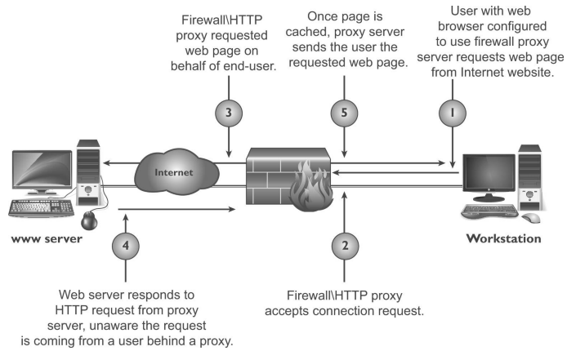
Proxy Firewall

Slide 114
Proxy Firewall: Circuit Level Proxies
Main purpose is to hide internal network and stop direct communications between external machines and internal machines.
Advantages
Fairly simple
Works with all network protocols
Hides internal network addresses
When used with a firewall, stops people from directly starting conversations with internal hosts, while still allowing internal hosts to communicate with the Internet
Disadvantages
A single point of failure and performance issues
Does not analyze data does not protect from dangerous data
Cannot protect against, violations in the protocol or bad data being passed around,

Slide 115
Proxy Firewall: Application Proxies
Advantages
Application proxies understand the protocol, so they can add extra security
Can have advanced logging/auditing and access control features
Ex. Restrict users to only allowed websites
Ex. Inspect data for protocol violations
Ex. Inspect data for malware (viri etc)
Disadvantages
Extra processing requires extra CPU (slower)
Proxies ONLY understand the protocols they were written to understand. So you generally have a separate application proxy for EACH protocol you want to proxy

Slide 116
Kernel Proxy Firewall
Considered a fifth-generation firewall.
Differs from all the previously discussed firewall technologies because it creates dynamic, customized network stacks when a packet needs to be evaluated.
When a packet arrives at a kernel proxy firewall, a new virtual network stack is created, which is made up of only the protocol proxies necessary to examine this specific packet properly.
E.g. If it is an FTP packet, then the FTP proxy is loaded in the stack. The packet is scrutinized at every layer of the stack.
This means the data link header will be evaluated along with the network header, transport header, session layer information, and the application layer data.
If anything is deemed unsafe at any of these layers, the packet is discarded.

Slide 117
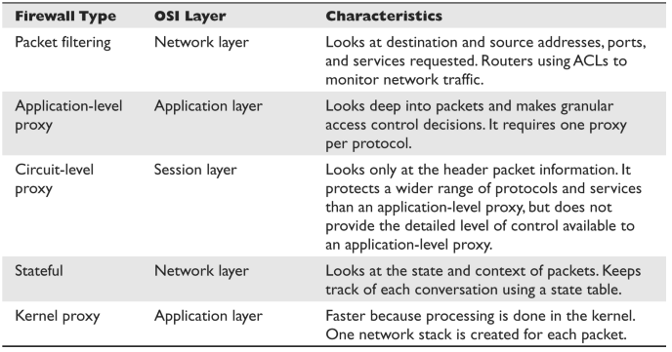
Comparison of Different Firewall Types

Slide 118
NAT/PNAT
A proxy that works without special software and is transparent to the end users.
Remaps IP addresses, allowing you to use private addresses internally and map them to public IP addresses
NAT allows a one-to-one mapping of IP addresses
PAT allows multiple private address to share one public address

Slide 119
Overall Firewall best practices
Block un-necessary ICMP packets types.
(Be careful though, know your environment)
Keep ACLS simple
Use Implicit deny*
Disallow source routed packets*
Use least privilege*
Block directed IP broadcasts
Perform ingress and egress filtering*
Enable logging
Drop fragments or re-assemble fragments

Slide 120
Overall Firewall issues
Potential bottleneck
Can restrict valid access
Often mis-configured
Except for application proxies firewalls generally do not filter out malware or improper content.
Doesn’t protect against internal attacks!*

Slide 121
Firewall Architecture

Slide 122
Key Terms
Bastion host A highly exposed device that will most likely be targeted for attacks, and thus should be properly locked down.
Dual-homed firewall This device has two interfaces and sits between an untrusted network and trusted network to provide secure access. A multihomed device just means it has multiple interfaces. Firewalls that have multiple interfaces allow for networks to be segmented based upon security zone, with unique security configurations.
Screened host A firewall that communicates directly with a perimeter router and the internal network. The router carries out filtering activities on the traffic before it reaches the firewall.
Screened subnet architecture When two filtering devices are used to create a DMZ. The external device screens the traffic entering the DMZ network, and the internal filtering device screens the traffic before it enters the internal network.
Proxy server A system that acts as an intermediary for requests from clients seeking resources from other sources. A client connects to the proxy server, requesting some service, and the proxy server evaluates the request according to its filtering rules and makes the connection on behalf of the client. Proxies can be open or carry out forwarding or reverse forwarding capabilities.

Slide 123
Security Zones
It is common practice in network and physical security to group different security levels into different areas or zones.
Each zone is either more or less trusted then the other zones.
Interfaces between zones have some type of access control to restrict movement between zones (like biometric and guard stations) or firewalls.)
In Network security there is often a median zone between the Internet and internal network called a DMZ.

Slide 124
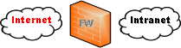






Firewall Architectures
Architecture 1: Single Firewall – No Router
Architecture 4: Screened Subnet: Dual Inline Firewalls
Architecture 2: Screened Host: Single Firewall – Border Router
Architecture 5: Firewall – VPN
Architecture 3: Dual Firewall – Border Router
Architecture 6: Firewall – VPN – Border Router

Slide 125
DMZ
A buffer zone between an unprotected network and a protected network that allows for the monitoring and regulation of traffic between the two.
Internet accessible servers (bastion hosts) are placed in a DMZ between the Internet and Internal network

Slide 126
DMZ architectures
Multi-homed Firewall
Screened Subnet

Slide 127
Multi Homed Firewall
Multi-homed firewalls may be used to setup a DMZ with a single firewall. (see next slide)
On any multi-homed machine, IP forwarding should be disabled.*

Slide 128

Multi-homed firewall

Slide 129
Screened Subnet
In a screen subnet, there is a separate firewall on both sides of the DMZ.
When using this model it is recommended that each firewall be a different vendor/product.
Diversity of defense*

Slide 130

Screened Subnet

Slide 131
Additional Network Terms

Slide 132
Additional Security Concepts
Honey pot – a machine left open for attackers to attack.
Honey net – an entire network left open for attackers to attack.
Know the difference between entrapment and enticement?*
Tarpits, which are similar to honeypots in that they appear to be easy targets for exploitation.
A tarpit can be configured to appear as a vulnerable service that attackers will commonly attempt to exploit. Once the attackers start to send packets to this “service,” the connection to the victim system seems to be live and ongoing, but the response from the victim system slows down communications.

Slide 133

Unified Threat Management (UTM)
Developed that provide all (or many) of these functionalities in a single network appliance.
The goals of UTM are simplicity, streamlined installation and maintenance, centralized control, and the ability to understand a network’s security from a holistic point of view.
The list includes, but is not limited to, firewalls, antimalware , antispam, IDS/ IPS, content filtering, data leak prevention, VPN capabilities, and continuous monitoring and reporting.

Slide 134
Cloud Computing
Looking at computing as a service that can be purchased, rather than as a physical box, can offer the following advantages:
Organizations have more flexibility and agility in IT growth and functionality.
Cost of computing can be reduced since it is a shared delivery model. (Includes reduction of real-estate, electrical, operational, and personnel costs.)
Location independence can be achieved because the computing is not centralized and tied to a physical data center.
Applications and functionality can be more easily migrated from one physical server to another because environments are virtualized.
Improved reliability can be achieved for business continuity and disaster recovery without the need of dedicated backup site locations.
Scalability and elasticity of resources can be accomplished in near real time through automation.
Performance can increase as processing is shifted to available systems during peak loads.

Slide 135

Cloud Computing Models

Slide 136
VPNs

Slide 137
VPN
Virtual Private Network – Generic term for building a secure virtual network over a public network
Often used for remote access for users
Often used to tie organizations remote offices together

Slide 138
Summary of Tunneling Protocols
Point-to-Point Tunneling Protocol (PPTP):
Works in a client/ server model • Extends and protects PPP connections • Works at the data link layer • Transmits over IP networks only
Layer 2 Tunneling Protocol (L2TP):
Hybrid of L2F and PPTP • Extends and protects PPP connections • Works at the data link layer • Transmits over multiple types of networks, not just IP • Combined with IPSec for security
IPSec:
Handles multiple VPN connections at the same time • Provides secure authentication and encryption • Supports only IP networks • Focuses on LAN-to-LAN communication rather than user-to-user • Works at the network layer, and provides security on top of IP
Secure Sockets Layer (SSL):
Works at the transport layer and protects mainly web-based traffic • Granular access control and configuration are available • Easy deployment since SSL is already embedded into web browsers • Can only protect a small number of protocol types, thus is not an infrastructure-level VPN solution

Slide 139
Tunneling
A component of some VPNs - Tunnel encapsulates one protocol within another protocol to create a virtual network.
Can encrypts original IP headers
Can encrypts data
Allows for routing non routable protocols and IP addresses
Can provide remote/internal IP addresses

Slide 140
Transport
Transport does not tunnel IP within IP. It only encapsulates the transport layer and above to protect the DATA.
Can encrypt DATA
Can provide origin authentication
Cannot encrypt original IP headers*
Does not provide remote/internal IP addresses*

Slide 141

Transport vs. Tunnel

Slide 142
Remote Access Best Practices
Always authenticate users
Use multi-factor authentication
Audit access
Answer modems after 4 rings (modems)
Use caller id (modems)
Use callback (modems)
use VPNs

Slide 143
Wireless

Slide 144
Wireless
Wireless, very common now.
No wires
Easy to use
Uses CSMA/CA
Shared Medium
Problems?

Slide 145
Spread Spectrum
Spreads communication across different frequencies available for the wireless device.
Frequency Hopping Spread Spectrum
Hop between frequencies (helps if other devices use same frequencies) (doesn’t use the entire “bandwidth of frequencies)
Harder for eavesdroppers (if everybody didn't know the sequence.. Which they actually do)
Direct Sequence Spread Spectrum
Sends data across entire bandwidth, using chipping code* along with data to appear as noise to other devices.

Slide 146
Wireless Components
Access points are like wireless hubs, they create a infrastructure WLAN
If you use just wireless cards of computers to communicate together that is called an ad-hoc* network.
Wireless devices must use the same channel
Devices are configured to use a specific SSID (often broadcasted)

Slide 147
Infrastructure Vs. Ad Hoc
When APs are used to connect wireless and wired networks, this is referred to as an infrastructure WLAN, which is used to extend an existing wired network.
When there is just one AP and it is not connected to a wired network, it is considered to be in standalone mode and just acts as a wireless hub.
An ad hoc WLAN has no APs; the wireless devices communicate with each other through their wireless NICs instead of going through a centralized device. To construct an ad hoc network , wireless client software is installed on contributing hosts and configured for peer-to-peer operation mode.

Slide 148

Characteristics of Wireless Security Structures

Slide 149

Making the Most of Limited Spectrum

Slide 150

Evolving Mobile Technology

Slide 151
Cell Phone Security
Since mobile phones are basically small computers, most of the same security vulnerabilities, threats, and risks carry over for this emerging technology.
They are penetrated through various attack vectors,
They are infected with malware,
Sensitive data are stolen from them,
Denial-of-service attacks can take place, and
Now that individuals and companies are carrying out credit card transactions on them.
The largest hurdle of securing any mobile or portable device is that people do not always equate them to providing as much risk as a workstation or laptop.

Slide 152
Bluetooth
Bluetooth is a Personal Area Network protocol designed to free devices from physical wires.
Bluetooth Modes
Discovery Mode
Automatic Pairing

Slide 153
Bluetooth Attacks
Blue jacking
Sending forged message to nearby bluetooth devices
Need to be close
Blue Snarfing
Copies information off of remote devices
Blue bugging
More serious
Allows full use of phone
Allows one to make calls
Can eavesdrop on calls

Slide 154
Bluetooth Countermeasures
Disable it if your not using it
Disable auto-discovery
Disable auto-pairing

Slide 155
Attacks against Networks and Software

Slide 156
Network Attacks
Back-door
DoS
Eavesdropping
Piggybacking
Session Hijacking
Spoofing
Unauthorized Access
Use of network for non-business purposes
Eavesdropping (passive and active)
Denial of Service
Network Intrusion
Probing

Slide 157

SYN Flood

Slide 158
SYN Flood
Attack
Forge IP SYN packet from downed system
Server responds to fake downed address, which never responds
Use up all the listen queue slots
Stops real new connections from establishing
Countermeasures
Drop forged packets at routers
Patch OS
Decrease 3 way handshake timeout values
Increase 3 way handshake max connections
Use a firewall as a middleman

Slide 159

Session Hijacking
Credit… www.OWASP.org

Slide 160

Man in the Middle (MITM)
Credit… www.OWASP.org

Slide 161
DDoS
Distributed Denial of Service – a brute force method that generally uses zombies or bots to build a botnet to overwhelm a target.
May consist of a hierarchy of Attacker, Masters and Slaves (see image)

Slide 162

DDoS

Slide 163
Network Virtualization

Slide 164



Slide 165
Final Thoughts

Slide 166
From Authorities to Audits
Examples
Technical, physical, and administrative requirements that must be in place to ensure compliance with the authorities
Statements of how a company will implement and enforce requirements
Implementation of the technical, physical, and administrative requirements found in the policy statements
Verification of appropriately implemented controls to comply with requirements
PCI
HIPAA
NERC
Authorities
Requirements
Policies
Controls
Audits
PCI-DSS Example
Authority: PCI-DSS is the authority document created by the PCI-SSC.
Requirement: (10.6) Review logs for all system components at least daily.
Policy: Monitoring Policy – States logs will be reviewed at least daily.
Control: Tool XYZ provides real-time monitoring for all system components.
Audit: Auditor verifies Tool XYZ is appropriately monitoring and alerting to actionable events. Audit results and evidence are stored as part of the audit.

Slide 167
Effectively Managed IT Controls
Technology can affect every part of the business.
At its best, technology is a competitive advantage.
At its worst, technology is your competitor’s advantage.
Product
Market Relationships
IT Controls:
Detective, protective and reactive measures in place to protect the confidentiality, integrity, and availability of business information and ensure appropriate management of the IT function to meet business objectives.
Inbound Logistics
Operations
Outbound Logistics
Marketing
and Sales
Service
Firm Infrastructure
HR Management
Margin
Procurement
Technology Development
Notes:
Compliance Control: A process, effected by management and other personnel, designed to provide reasonable assurance that transactions are executed in accordance with 1) laws governing the use of budget authority and other laws and regulations that could have a direct and material effect on the financial statements or required supplementary stewardship information and 2) any other laws, regulations, and government wide policies identified in OMB audit guidance. [GAO/PCIE Financial Audit Manual]
Source: http://www.unifiedcompliance.com/it_compliance/language_compliance/definitions/c.html

Slide 168
Chris Davis
UTD Email: cmd140430@utdallas.edu
Google Voice: 214-771-8122
Course Materials
https://elearning.utdallas.edu

Slide 169
Additional Materials

Slide 170

Today's Materials
Harris, Shon (2012-11-08).
CISSP All-in-One Exam Guide, 6th Edition.
McGraw-Hill Education.

